Slide 1

Major Project Phase-I
An Investigation Hardware design for portable ECG monitoring using Machine Learning
Under the Supervision
Dr. Syed Thouheed Ahmed
Presented By:
Md Kaif Mustafa (R21EJ020)
Rahul Kumar Singh (R21EJ026)

Slide 2
Overview
Abstract
Introduction
Components Overview
Block Diagram and Working Principle
Circuit Design and Setup
Cost Breakdown (in INR)
Software Implementation
Machine Learning Algorithms
Challenges Faced
Conclusion

Slide 3

Abstract
This project investigates the design and development of a portable Electrocardiogram (ECG) monitoring device that leverages Machine Learning (ML) to enhance real-time heart health diagnostics.
As cardiovascular diseases remain one of the leading causes of mortality worldwide, continuous monitoring and early detection are crucial. The proposed hardware design integrates lightweight, power-efficient components with a compact form factor, making it highly portable for everyday use.
The ECG signals are collected through bio-electrodes, which are processed and analyzed using embedded ML algorithms trained to detect arrhythmias and other cardiac abnormalities.
The ML models are optimized to operate on low-power microcontrollers, enabling real-time analysis directly on the device without reliance on external servers or high computational resources.
This approach ensures both user privacy and reduced latency in anomaly detection. In addition, the device is designed to be user-friendly, with a simple interface to display results and wireless connectivity for easy data transfer to mobile devices or cloud storage for extended monitoring and medical consultation.
Preliminary results demonstrate that this ML-based portable ECG system provides high accuracy in detecting various cardiac irregularities, offering a reliable, accessible solution for early heart health monitoring and intervention.
01

Slide 4
Introduction
Cardiovascular diseases (CVDs) are a leading cause of death globally, accounting for millions of lives lost each year. Early detection and continuous monitoring of heart health are essential for effective intervention and treatment. Traditionally, ECG monitoring is conducted in clinical settings using bulky, stationary equipment. However, with the rise of wearable technology and advancements in low-power electronics, there is a growing opportunity to bring ECG monitoring into everyday environments through portable devices.
This project aims to design and develop a portable ECG monitoring device that integrates hardware and machine learning (ML) to enable accurate, real-time cardiac health monitoring outside of clinical environments. Unlike conventional ECG devices, this device will use bioelectrodes to capture ECG signals and will process these signals through embedded ML algorithms capable of detecting common cardiac irregularities, such as arrhythmias, in real time.
The ML algorithms are optimized to run on a low-power microcontroller, minimizing power consumption while maximizing device portability and battery life. • In addition to hardware design, the system incorporates an intuitive user interface and wireless connectivity, allowing users to easily view their heart data and transfer it to mobile devices or cloud storage for long-term monitoring and analysis. The device's real-time monitoring and user-friendly design make it suitable for individuals who need continuous heart monitoring, such as elderly patients, athletes, or those at risk of cardiovascular conditions.
02

Slide 5
Components Overview
AD8232 ECG Sensor Module: Amplifies and filters the heart signals, providing a clean analog ECG waveform.
Input Voltage: 3.3V to 5V
Output: Analog ECG signal
Arduino Nano: The primary microcontroller used for signal processing and data handling.
Processor: ATmega328
Digital I/O Pins: 14 (6 PWM outputs)
Analog Input Pins: 8
HC-06 Bluetooth Module: Used for wireless transmission of the data to a smartphone or computer.
Bluetooth Protocol: Bluetooth v2.0
Operating Voltage: 3.3V to 5V
Range: Up to 10 meters
03

Slide 6
Machine Learning Model Integration -Model Selection and Training Train a machine learning model, such as a convolutional neural network (CNN) or support vector machine (SVM), on a dataset of ECG signals to classify normal and abnormal rhythms (e.g., arrhythmias).
Model Optimization for Embedded Systems Optimize the trained model for deployment on the microcontroller by using techniques like model quantization, pruning, or converting it to a TensorFlow Lite or TinyML format. This ensures the model runs efficiently with limited computational resources.
Embedded ML Integration Program the optimized model into th
Electrodes: Capture heart activity signals when placed on specific body locations.
Material: Silver/Silver Chloride (Ag/AgCl)
Type: Disposable
Rechargeable Battery Pack: Powers the complete circuit, ensuring portability.
Battery Type: Lithium Polymer (Li-Po)
Voltage: 3.7V
Capacity: 1000mAh
04

Slide 7
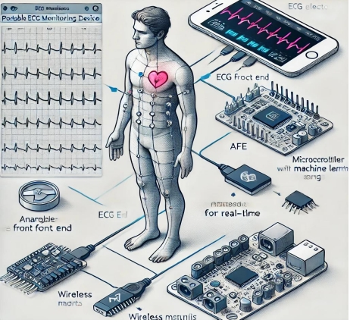
Block Diagram and Working Principle
Refinements and Enhancements Make necessary adjustments based on testing results to improve accuracy, power efficiency, and user experience.
Documentation Compile detailed documentation, including system architecture, circuit diagrams, model training, and deployment processes, as well as guidelines for device operation and maintenance.
Deployment Finalize the device for deployment, preparing prototypes for further testing or potential commercialization.
05

Slide 8
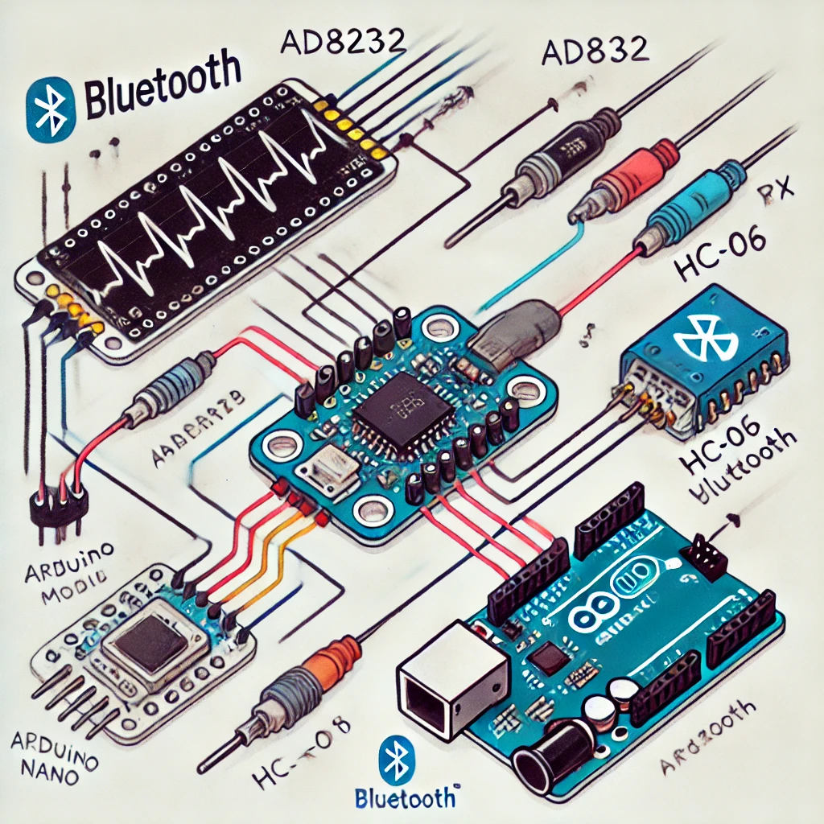
Circuit Design and Setup
The circuit consists of the AD8232 ECG module connected to the analog input pin of the Arduino Nano.
The Bluetooth module is connected to the UART pins (TX/RX) of the Arduino for wireless communication.
A battery pack powers the Arduino and sensor module.
To view the ECG signals, the user must connect the Bluetooth module to a mobile device or a laptop and use an ECG visualizer application.
06

Slide 9

Cost Breakdown (in INR)
AD8232 ECG Module: INR 440 to INR 504
Arduino Nano: INR 300 to INR 450
Electrodes: INR 50 to INR 100 per set
Bluetooth Module (HC-06): INR 200 to INR 300
Battery Pack: INR 200 to INR 300
Enclosure: INR 150 to INR 300
Display Module: INR 150
Miscellaneous Components: INR 100
Total Estimated Cost: INR 1,500 to INR 2,500
07

Slide 10
Software Implementation
The Arduino Nano is programmed to read analog signals from the AD8232 module, process them, and send the values to the Bluetooth module.
Hardware Development: We’ve selected and are assembling components, including the ECG electrodes, AFE, microcontroller, and display, ensuring the device is compact and energy-efficient.
Signal Processing: The AFE filters and amplifies the ECG signals, and we’re working to ensure high signal quality for reliable analysis.
Machine Learning Integration: A lightweight machine learning model, trained to detect heart rhythm anomalies, is being embedded onto the microcontroller for real-time analysis.
Mobile App Development: A mobile app is being developed to visualize heart data and allow users to store it securely.
Testing: The device is undergoing functional and accuracy tests to make sure it works reliably and efficiently in real-world conditions.
08

Slide 11
Machine Learning Algorithms
Support Vector Machine (SVM) Description: SVM is a popular machine learning algorithm for classifying ECG signals. It works well with binary classification (normal vs. abnormal) by finding the optimal boundary between classes.
Pros: Effective in cases with a clear margin of separation; simple to deploy and interpret.
Cons: SVMs can be less efficient on ECG data with many classes or where real-time processing is needed.
Convolutional Neural Network (CNN) Description: CNNs are widely used for image and signal processing, making them suitable for ECG data. They automatically learn spatial hierarchies and features, which helps detect complex patterns like arrhythmias.
Pros: Excellent at capturing patterns in ECG waveforms, high accuracy in identifying multiple arrhythmias.
Cons: Computationally intensive, which can strain low-power microcontrollers unless optimized.
Long Short-Term Memory (LSTM) Description: LSTMs are a type of recurrent neural network (RNN) that are ideal for time-series data like ECGs because they can learn from sequential dependencies. Pros: Effective for detecting temporal patterns and trends in ECGs, allowing for accurate classification.
Cons: Requires more computation and memory, challenging for real-time embedded applications..
09

Slide 12
Machine Learning Algorithms
Random Forest (RF) Description: A Random Forest classifier uses multiple decision trees to make classifications, which can work well on ECG data with straightforward classifications.
Pros: Easier to interpret; less computationally demanding than deep learning models.
Cons: Less effective for complex ECG patterns, may miss subtle irregularities.
Efficiency: Moderate, suitable for simpler cases of anomaly detection.
K-Nearest Neighbors (KNN) Description: KNN is a simple algorithm that classifies an instance based on the majority class of its nearest neighbors.
Pros: Straightforward to implement, especially for binary classifications.
Cons: Memory-intensive and may struggle with real-time performance on continuous data.
Efficiency: Low for this purpose, as it lacks scalability. Recommended Algorithm: Optimized CNN Model
Why CNN? CNNs are highly efficient in identifying intricate ECG patterns and can accurately classify various arrhythmias. By using model compression techniques (like quantization and pruning), CNNs can be optimized to run on low-power microcontrollers without significantly sacrificing accuracy.
Expected Efficiency: High accuracy and responsiveness with real-time processing capability, making CNNs one of the best choices for a portable ECG device. An optimized CNN model strikes the right balance of accuracy, efficiency, and suitability for real-time ECG anomaly detection in this application.
10

Slide 13
Challenges Faced
Signal Noise: The ECG signal is very weak, making it susceptible to noise from power lines and movement artifacts.
Bluetooth Interference: Ensuring a stable wireless connection in environments with multiple devices was challenging.
Electrode Placement: The correct placement of electrodes is crucial for accurate signal acquisition.
11

Slide 14
Conclusion
The portable ECG machine is a low-cost, compact device that offers an efficient solution for remote cardiac monitoring.
It can be used for continuous health monitoring in patients with heart conditions or as an educational tool for students.
The project demonstrates the application of biomedical electronics and opens up possibilities for future research.
12

Slide 15
Thank You

